Slide 1

Individual Homework
Crudu Iulian, group 912

Slide 2
Problem statement
H1: It is not sunny this afternoon and it is colder than yesterday.
H2: We will go swimming only if it is sunny.
H3: If we do not go swimming, then we will take a canoe trip.
H4: If we take a canoe trip, then we will be home by sunset.
C: We will be home by sunset.
Is C deducible from the set of hypotheses {H1,H2,H3,H4}?
If yes, build its deduction
We have to check whether the following deduction holds:
H1,H2,H3,H4 |— C

Slide 3
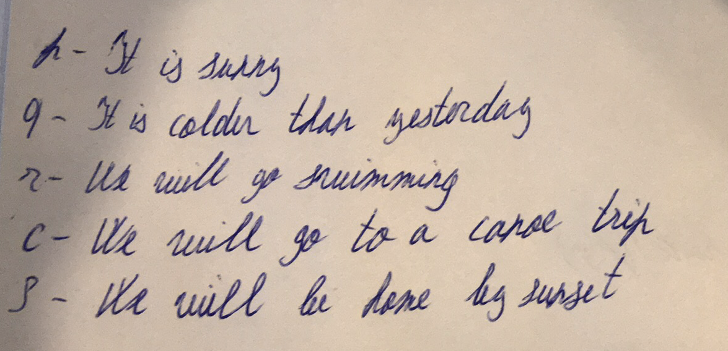
Notations for the propositional variables

Slide 4
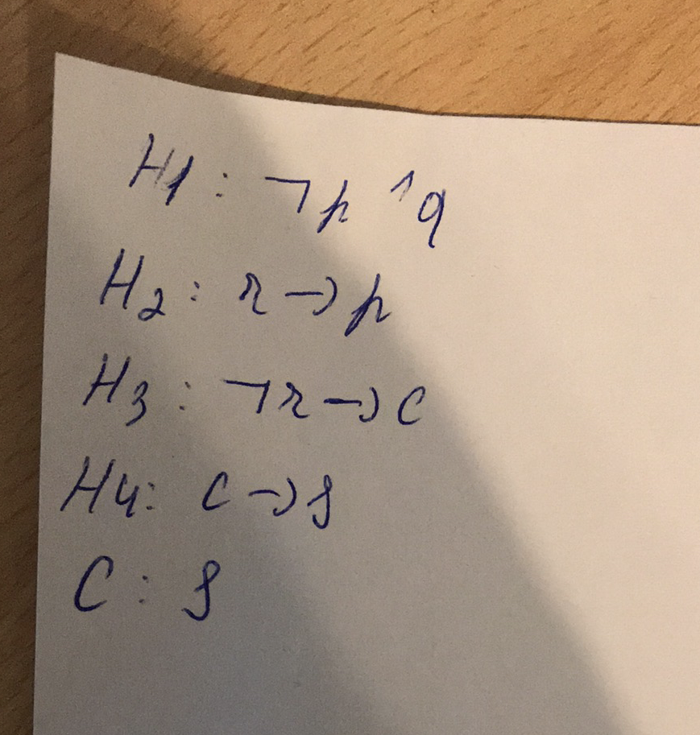
Propositional formulas

Slide 5
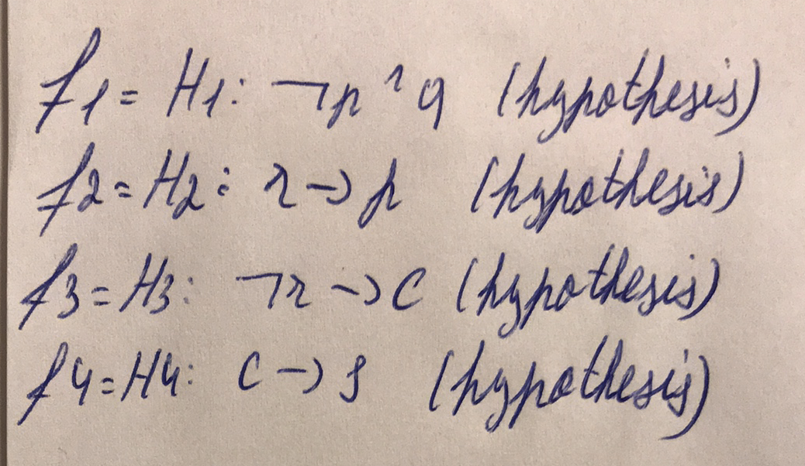
THe definition of the deduction and the axiomatic system are used.

Slide 6
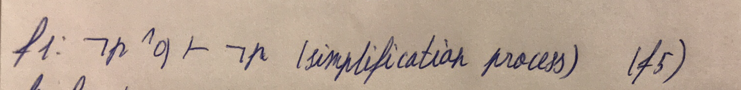
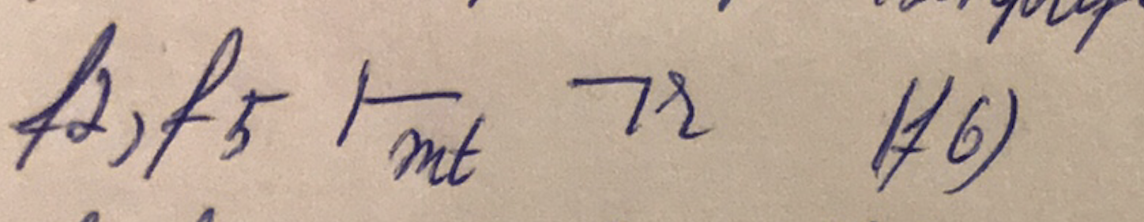
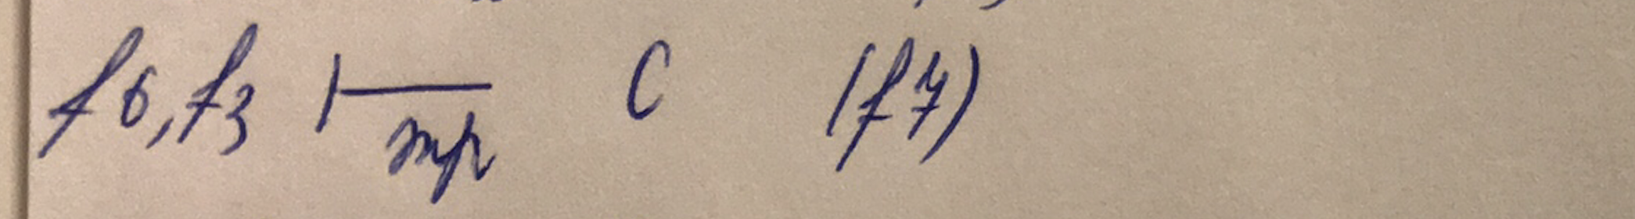
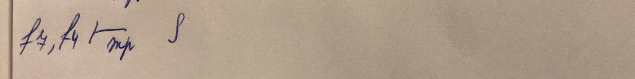
The deduction(inference) process:

Slide 7
The sequence of formulas: (f1, f2, f3, f4, f5, f6, f7) is the deduction of C from the hypotheses therefore, based on the hypetheses, We will be home by sunset.

